Slide 1
Adaptive Relevance Feedback in Information Retrieval Yuanhua Lv and ChengXiang Zhai (CIKM ‘09)
Date: 2010/10/12
Advisor: Dr. Koh, Jia-Ling
Speaker: Lin, Yi-Jhen

Slide 2
Outline
Introduction
Problem Formulation
A Learning Approach To Adaptive Relevance Feedback
Experiments
Conclusions

Slide 3
Introduction
Relevance Feedback helps to improve the retrieval performance.
The balance between the original query and feedback information is usually set to a fixed value $α$ $M=\left(1−α\right)g_{1}\left(Q\right)+ α g_{2}( J)$
This balance parameter should be optimized for each query and each set of feedback documents.
Notes:
because
If we over-trust the feedback information, we may be biased to favor a particular subset of relevant documents, but under-trusting it would not take advantage of feedback.

Slide 4
Problem Formulation
Three cases to set a larger feedback coefficient:
The query is discriminative
The feedback documents are discriminative
Divergence between a query and its feedback document is large
We assume there is a function B, that can map a query Q and the corresponding feedback documents J to the optimal feedback coefficient ( i.e.,$α$ = B(Q,J) )
We explore the problem of adaptive relevance feedback in KL-divergence retrieval model and mixture-model feedback method

Slide 5
A Learning Approach To Adaptive Relevance Feedback
Heuristics and Features
Discrimination of Query
Discrimination of Feedback documents
Divergence between Query and Feedback Documents
Learning Algorithm

Slide 6
Discrimination of Query
Top-2 result documents
F’ ={ $f_{1}, f_{2}$ }
$f_{1}$ : $w_{1}{ f}_{2}$ : $w_{1}$
$(− \frac{2}{2}\log_{2}{\frac{2}{2}}$ ) $=$0
$f_{1}$ : $w_{1} { f}_{2}$ : $w_{2}$
$(−\frac{1}{1+1}\log_{2}{\frac{1}{1+1}}$ ) $+ (−\frac{1}{1+1}\log_{2}{\frac{1}{1+1}}$ )$=$1
$f_{1}$ : $w_{1} ,w_{2}{ f}_{2}$ : $w_{1}$ , $w_{2}$
$(−\frac{2}{2+2}\log_{2}{\frac{2}{2+2}}$ ) $+ (−\frac{2}{2+2}\log_{2}{\frac{2}{2+2}}$ )$=$1
Query Length
Q = “apple ipad case”, |Q| = 3
Entropy of Query
Based on top-N result documents F’
QEnt_A = $\sum_{ω∈F′}{−P(ω|θ_{F′})}\log_{2}{P(ω|θ_{F^{′}})}$
$P(ω|θ_{F′}$) = $\frac{c (ω, F′)}{\sum_{ω}{c (ω, F′)}}$
Clarity of Query
Kullback-Leibler divergence of the query model from the collection model
QEnt_R1 = $\sum_{ω∈Q}{p(ω|θ_{Q})}\log{\frac{p(ω|θ_{Q})}{p(ω|C)}}$
QEnt_R2 = $\sum_{ω∈F′}{p(ω|θ_{F′})}\log{\frac{p(ω|θ_{F′})}{p(ω|C)}}$
$P(ω|θ_{F′}$) = (1-$λ$) $P(ω|θ_{F′}$) +$λP(ω|C$) , $λ=$0.7
QEnt_R3 = $\log{(QEnt_R1)}$
QEnt_R4 = $e^{\text{QEnt}\text{_}\text{R}\text{2}}$

Slide 7
Discrimination of Feedback documents ( judged relevant by the user for feedback )
Feedback Length
D = {$d_{1,}d_{2,}d_{3,}d_{4,}d_{5}$} , |F| = 3
Feedback Radius
to measure if feedback documents are concentrated on similar topics
Entropy of Feedback Documents
FBEnt_A = $\sum_{ω∈F}{−P(ω|θ_{F})}\log_{2}{P(ω|θ_{F})}$
$P(ω|θ_{F}$) = $\frac{c (ω, F)}{\sum_{ω}{c (ω, F)}}$
Clarity of Feedback Documents
FBEnt_R1 = $\sum_{ω∈F}{p(ω|θ_{F})}\log{\frac{p(ω|θ_{F})}{p(ω|C)}}$
$P(ω|θ_{F}$) = (1-$λ$) $P(ω|θ_{F}$) +$λP(ω|C$) , $λ=$0.7
FBEnt_R2 = $e^{\text{FBEnt}\text{_}\text{R}\text{1}}$
FBEnt_R3 = $\sum_{ω∈F}{p(ω|θ_{T})}\log{\frac{p(ω|θ_{T})}{p(ω|C)}}$
$$d_{1,}d_{2,}d_{4}$$
$d_{1}:$ $w_{1}$, $w_{2}$, $w_{3}$
$d_{2}:$ $w_{1}$, $w_{2}$
$d_{4}$: $w_{1}$, $w_{2}$, $w_{3}$
$(−\frac{3}{3+3+2}\log_{2}{\frac{3}{3+3+2}}$ ) + $(−\frac{3}{3+3+2}\log_{2}{\frac{3}{3+3+2}}$ ) $+ (−\frac{2}{3+3+2}\log_{2}{\frac{2}{3+3+2}}$ )

Slide 8
Divergence between Query and Feedback Documents
Absolute Divergence
QFBDiv_A = $\sum_{ω∈F}{p(ω|θ_{F})}\log{\frac{p(ω|θ_{F})}{p(ω||θ_{F}′)}}$
$P(ω|θ_{F′}$) = $\frac{c \left(ω, F^{′}\right)+μ P \left(ω|C\right)}{\sum_{ω}{c (ω, F′)}+μ}$ , $μ=1500$
Relative Divergence
QFBDiv_R = $\sum_{d∈F}{\frac{prec(r_{d})}{K}}$
$r_{d}$: the rank of document d
$prec(r_{d}$) : precision of top $r_{d}$ documents
K : a constant
K=10 {$d_{1,}d_{2,}d_{3}$ $,d_{4,}d_{5}$}
$$d_{1,}d_{2,}d_{3}$$
$\frac{1}{10}+\frac{1}{10}+\frac{1}{10}$ = 0.3
$$d_{1,}d_{4,}d_{5}$$
$\frac{1}{10}+\frac{\frac{2}{4}}{10}+\frac{\frac{3}{5}}{10}$ = 0.21

Slide 9
Learning Algorithm
Logistic regression model
Its function form: $f \left(z\right) = \frac{1}{1+exp(−z)}$
z =$ω_{0}+ω_{1}χ_{1}+ω_{2}χ_{2}+…+ω_{k}χ_{k}$
We learn these weights from training data (e.g., past queries)
once the weights has been derived for a particular data set, the equation can be used to predict feedback coefficients for new data sets (i.e., future queries)
feature vector $\overset{→}{χ}$
( Query Length, Entropy of Query, Clarity of Query, Feedback Length, … , )

Slide 10
Experiments Experiment Design
TREC Data set
Assume top-10 results were judged by users for relevance feedback
KL-Divergence retrieval model with the mixture model feedback to get the optimal feedback coefficients for training queries; through trying different feedback coefficient $α∈${ 0.0, 0.1,…, 1.0 }

Slide 11
Experiments Sensitivity of Feedback Coefficient

Slide 12
Experiments Feature Analysis and Selection

Slide 13
Experiments Feature Analysis and Selection
an example:
Weights derived from Terabyte04&05 data
Given a new query, we can predict its feedback coefficient using the formula: $α= \frac{1}{1+exp(−z)}$

Slide 14
Experiments Performance of Adaptive Relevance Feedback
Evaluate in three variant cases :
Ideal: the training set and the testing set are in the same domain
Toughest: which is dominated by the data not in the same domain
Have sufficient training data in the same domain, but it is mixed with “noisy” data

Slide 15
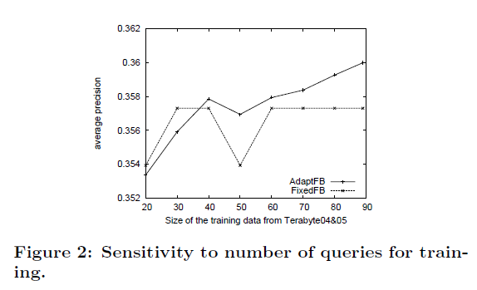
Experiments Performance of Adaptive Relevance Feedback
Ideal:

Slide 16
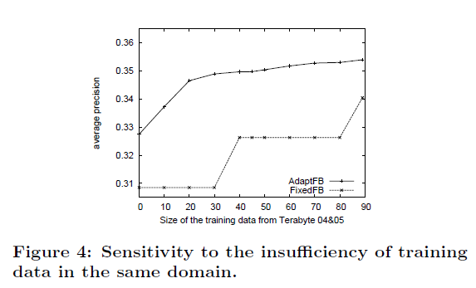
Experiments Performance of Adaptive Relevance Feedback
Toughest:

Slide 17
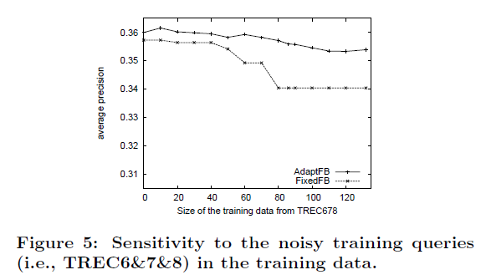
Experiments Performance of Adaptive Relevance Feedback
noisy:

Slide 18
Conclusions
Contributions
Propose an adaptive relevance feedback algorithm to dynamically handle the balance between query and feedback documents
Propose three heuristics to characterize the balance between original query and feedback information
Future work
Rely on explicit user feedback for training, how to adaptively exploit pseudo and implicit feedback
Apply on other feedback approach, e.g., Rocchio feedback, to examine its performance
Study more effective and robust features
Incorporate negative feedback into the proposed adaptive relevance feedback method

